Slide 1
Can External Memory Help in Visual and Symbolic Reasoning?
T.S. Jayram IBM Research AI Almaden Research Center, San Jose

Slide 2
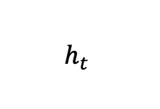
Recurrent Neural Networks
$$h_{t}$$
Elman [Elman 90]
LSTM [Hochreiter & Schmidhuber 97]
GRU [Cho et al. 14]
Notes:
successful approach to incorporate memory explicitly in artificial neural networks
But human memory is much more nuanced

Slide 3
Human Memory Subsystems
Short-term Memory
Long-term Memory
Temporary retention and repetition
e.g., repeating a phone number
Semantic memory
e.g., capital of France
Episodic memory
e.g., where you car is parked
Sustained neural activity (in seconds)
Limited capacity (4-7 items)
Synaptic strength plus structural changes (i.e., plasticity)
Very large capacity
Notes:
The brain consists of two kinds of memory.
Short-term/working memory focuses on temporary aspects and mainly consists of controlled attention and sequential access
Long-term memory focus on life-long aspects and has more powerful constructs such as content-addressing and temporal indexing

Slide 4
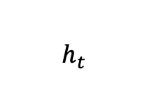
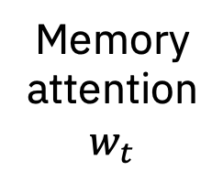
Memory-augmented Neural Networks
$$h_{t}$$
Models
Applications
NTM, DNC
[Graves et al. ’14, ’16]
Memory Networks
[Weston et al. ’15]
Memory attention $w_{t}$
Life-long learning
One-shot learning
Learning algorithms
Reasoning
textual, visual
Notes:
Memory in recurrent networks is not nuanced
Read/write shows similar behavior with attention
Models that address both short-term and long-term memory

Slide 5
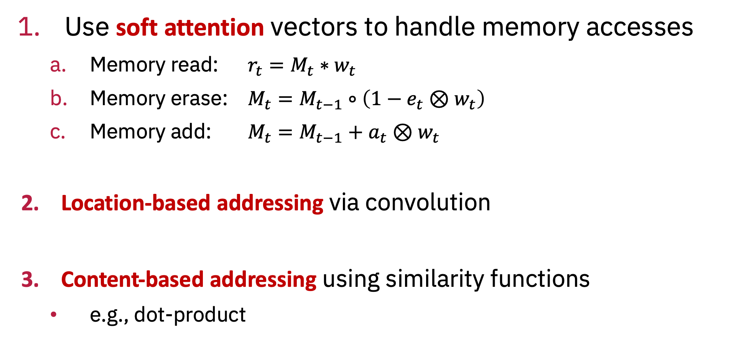
Memory Operations
Use soft attention vectors to handle memory accesses
Memory read: $r_{t}=M_{t}{∗w}_{t}$
Memory erase: $M_{t}=M_{t−1}∘\left(1−e_{t}⊗w_{t}\right)$
Memory add: $M_{t}=M_{t−1}+a_{t}⊗w_{t}$
Location-based addressing via convolution
Content-based addressing using similarity functions
e.g., dot-product

Slide 6
Design Principles
Cognitive models of short-term and long-term memory
Computer science algorithms & data structures
Intuition
Aspire to emulate human memory
Models are very powerful …
… but often difficult to train

Slide 7
Capturing working memory capacity effectively
Based on:
Controlling Attention To Solve Working Memory Tasks Using a Memory-Augmented Neural Network, CogSci ’19

Slide 8



Working Memory (WM)
Temporary retention and manipulation of information [Cowan 97]
7 x 14
408-927-1419
Planning..

Slide 9
Attention Control in Working Memory
WM is all about the capacity for controlled, sustained attention in the face of interference or distraction [Engle et al. 99]
attention-control is a fundamental component of WM and probably the main limiting factor for capacity [CE 94; EK 04]
the (in)ability to effectively parallel process two attention demanding tasks limits our multitasking performance

Slide 10
Performance Measures of Working Memory
Psychometric tasks are used to measure WM
Verbal and Visual working memory tasks
e.g., [Conway et al. 05; Clapp et al. 09]
Miller’s law: the number of objects an average human can hold in working memory is 7 ± 2

Slide 11
Simple Tasks

Slide 12
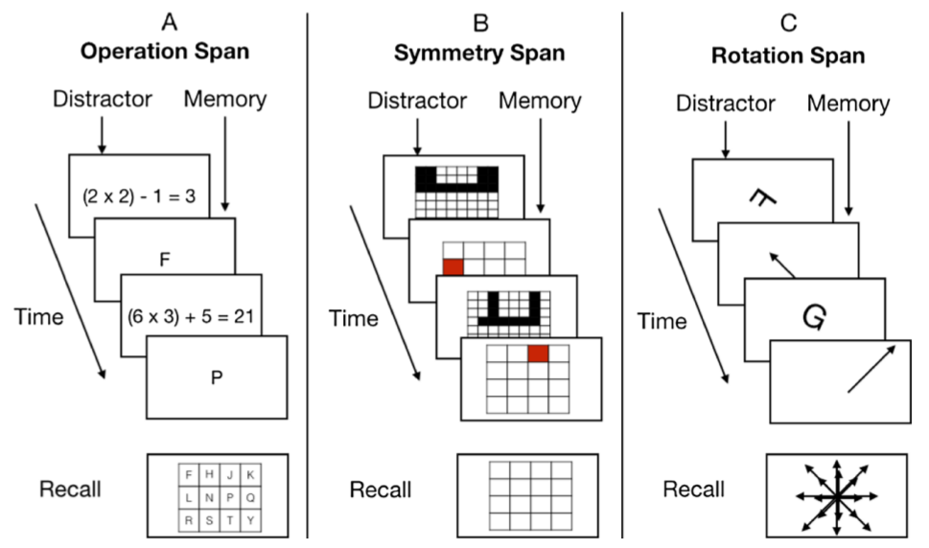
Complex Tasks

Slide 13
WM Tasks
(purely symbolic reasoning)
Notes:
Focus on reasoning and information processing
Not on visual and verbal artifacts

Slide 14
Differentiable Working Memory (DWM)
NTM [Graves et al. 14] with a single read/write head
uses location-based addressing only
Key addition: Bookmarks
stores system’s read/write head at previous time steps
cf. focus of attention in embedded-processes framework [Cowan 88]
pointers to representations stored in memory
in contrast, bookmarks are differentiable

Slide 15
DWM Architecture
Read/Write

Slide 16
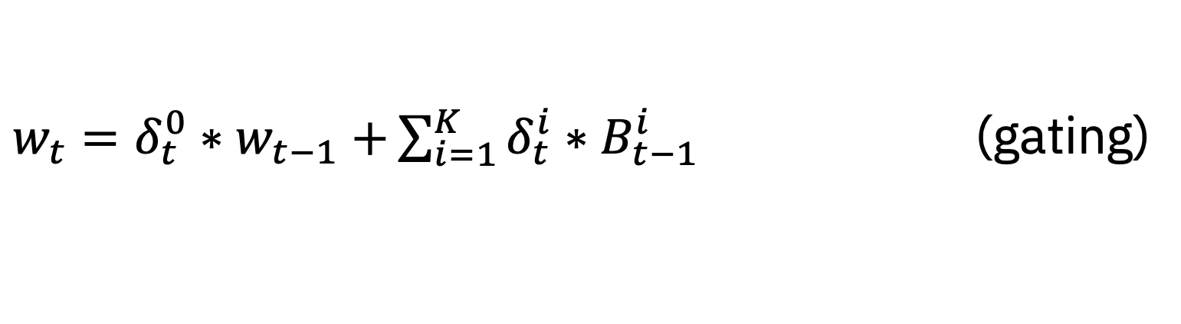
Operations in DWM
Record the read/write head in a bookmark
﻿Move the read/write head to any bookmark
Shift read/write head sequentially
$B_{t}^{i}=g_{t}^{i}{∗w}_{t−1}+(1−g_{t}^{i}{)∗B}_{t−1}^{i}$ (gating)
$w_{t}=δ_{t}^{0}{∗w}_{t−1}+\sum_{i=1}^{K}{δ_{t}^{i}{∗B}_{t−1}^{i}}$ (gating)

Slide 17
Training Performance
DWM achieves small training error in half the time needed for DNC or LSTM (sequence length 10-20)
#params of DWM ~ 1100 vs. DNC ~4500 and LSTM ~ 5M

Slide 18
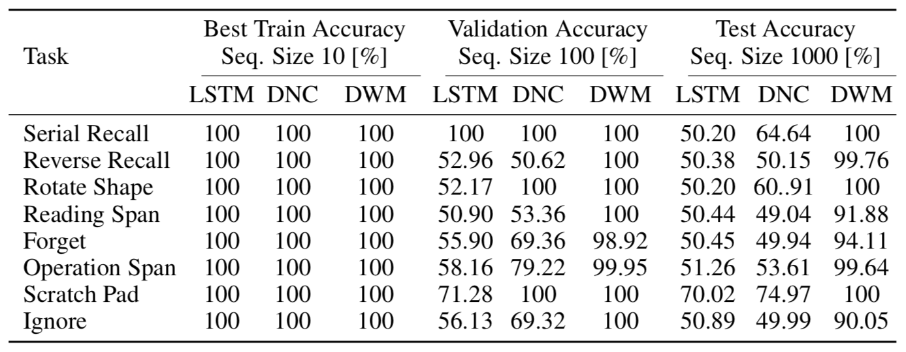
Generalization
DWM generalizes across task sizes significantly better than DNC or LSTM (i.e., learns attention control)

Slide 19
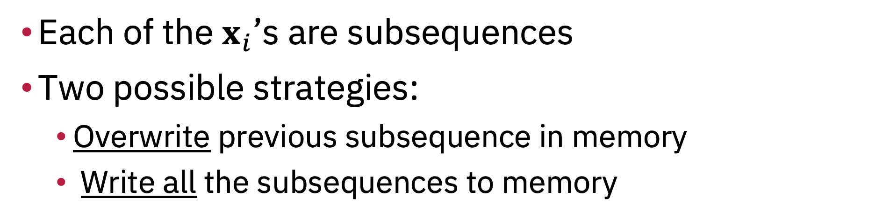

Interpretable behavior of DWM [2 bookmarks]
Scratch Pad task
Input: $x_{1}{ x}_{2} ……x_{k} | —$
Output: $—— …… — |$ $x_{k}$
Each of the $x_{i}$’s are subsequences
Two possible strategies:
Overwrite previous subsequence in memory
Write all the subsequences to memory

Slide 20
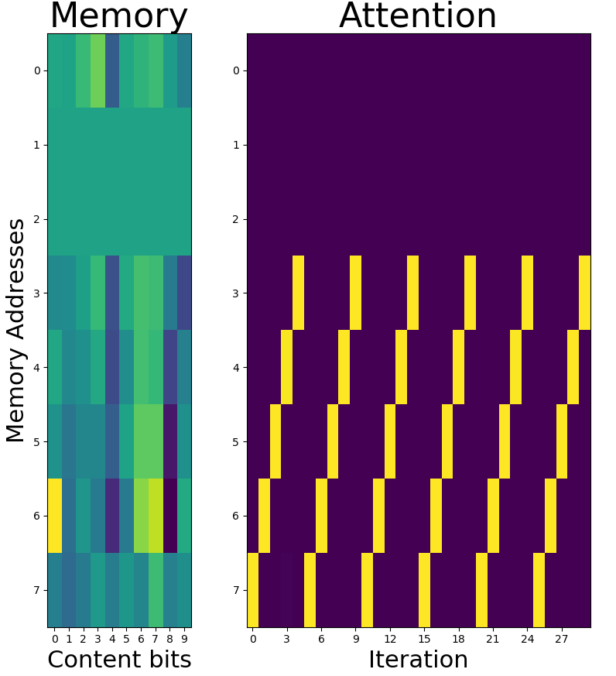


Scratch Pad Task
$$x_{1}$$
$$x_{2}$$
Overwrite Strategy

Slide 21
DWM Summary
Encoding relevant inputs using neural encoding instead of pure symbols
Using the encoding to solve the task via sequential access to memory
Using bookmarks to control attention in memory in the face of interference or distraction

Slide 22
Video reasoning using selective attention memory
Based on:
﻿Visually Grounded Reasoning with Temporal Concepts in Selective Attention Memory. Under Review.

Slide 23
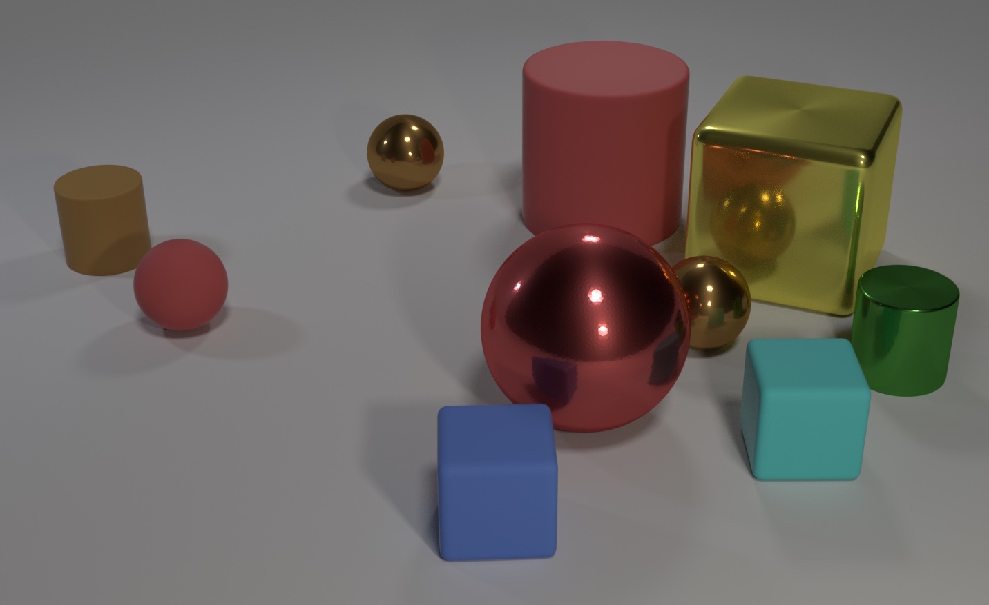
Visual Reasoning
CLEVR [Johnson et al.’15]
Object-attribute associations
Object-object comparisons
Spatial relationships
Counting
Q: How many objects are either small cylinders or blue things?
A: 3
Notes:
Popular dataset that brought into sharp focus the challenges of visual reasoning

Slide 24
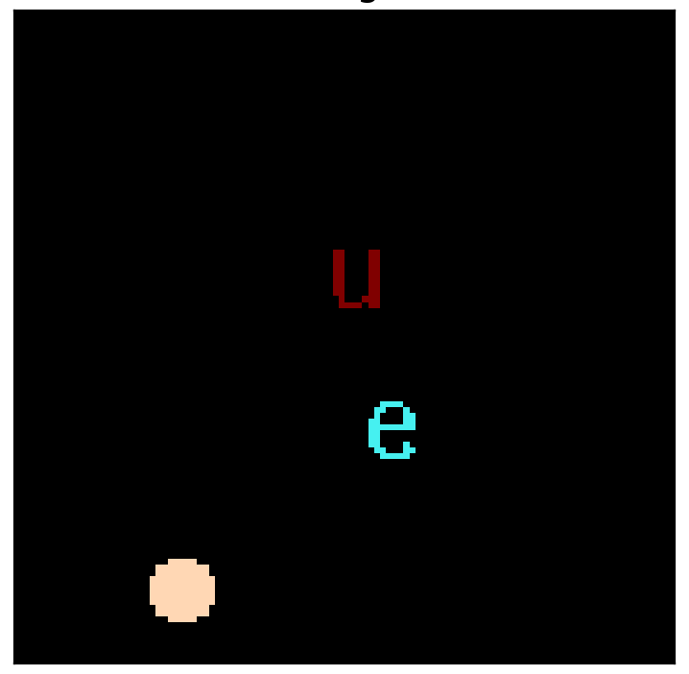
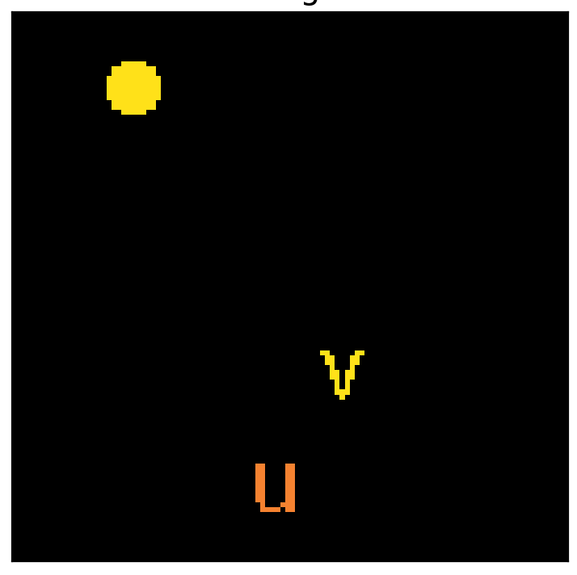
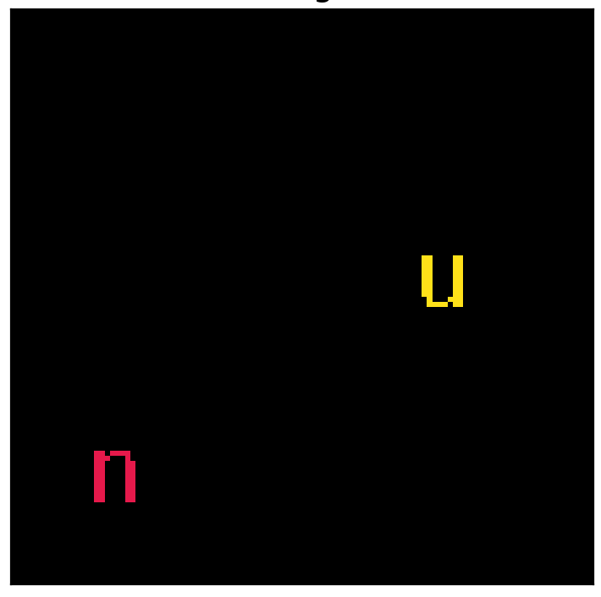
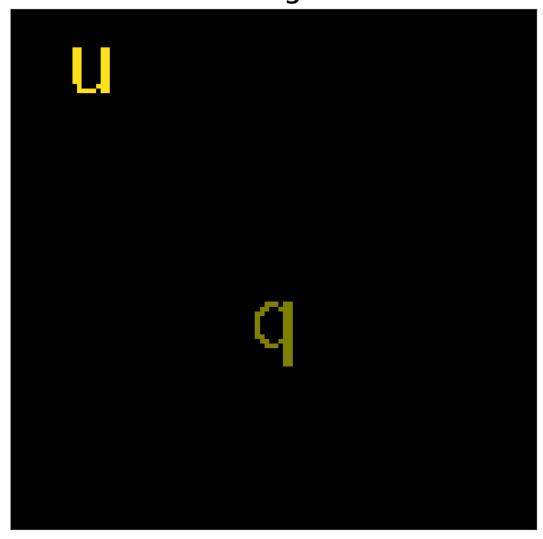
Video Reasoning
Frame 1
Frame 2
Frame 3
Frame 4
Q: Does color of u now equal color of latest circle? A: True
COG [Yang et al.’18]
Temporal concepts

Slide 25
Selective Attention Memory Network
End-to-end differentiable model with external memory
Uses both location-based and content-based addressing
Classifier to determine temporal context, e.g., “latest”
Module for neuro-symbolic reasoning:
Should the memory be updated with a new object?
If so, should the new object replace an existing one or be added to memory?
Should the relevant object for this reasoning step be extracted from current frame or from memory?

Slide 26
Video Reasoning
Frame 1
Frame 2
Frame 3
Frame 4
Q: Does color of u now equal color of latest circle? A: True

Slide 27
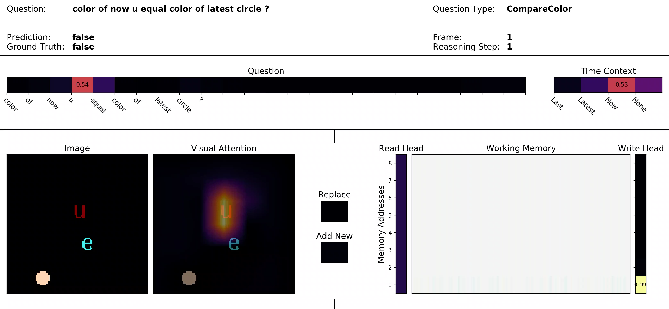

Slide 28
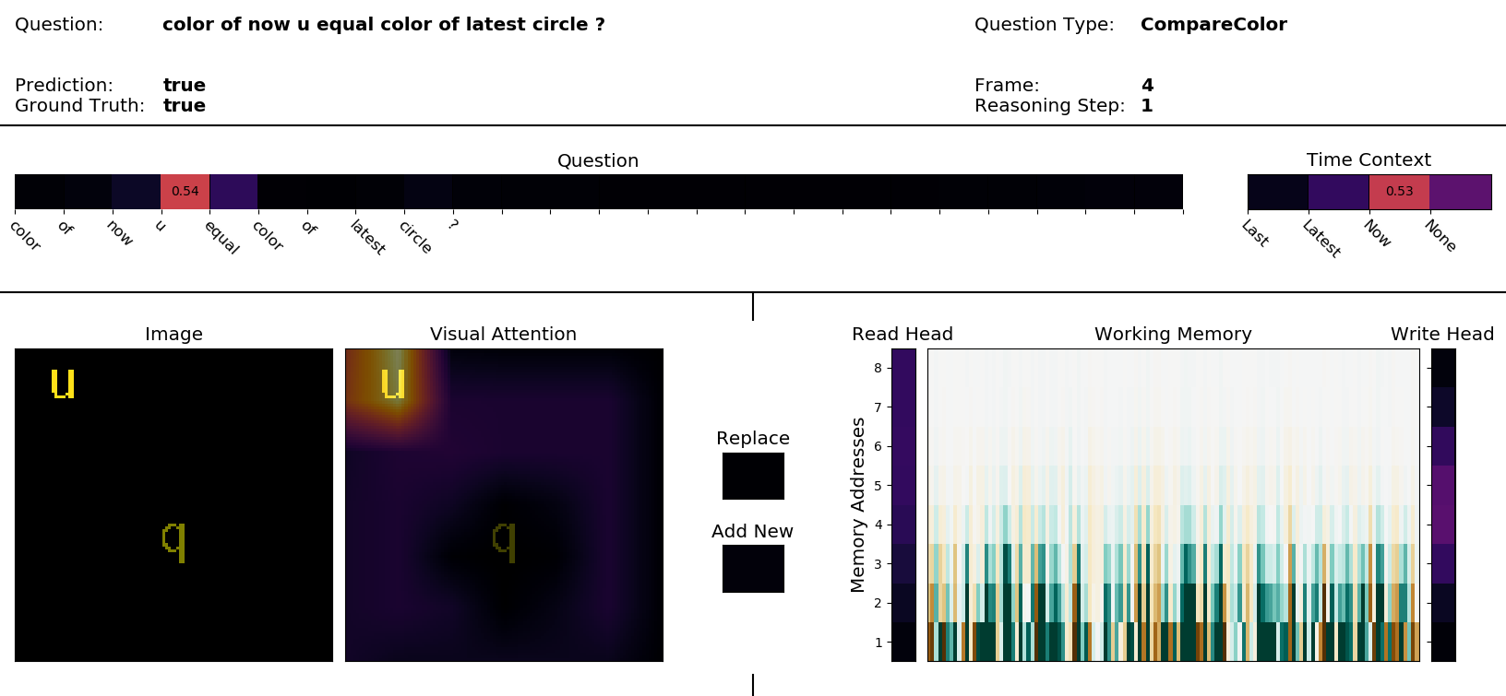

Slide 29
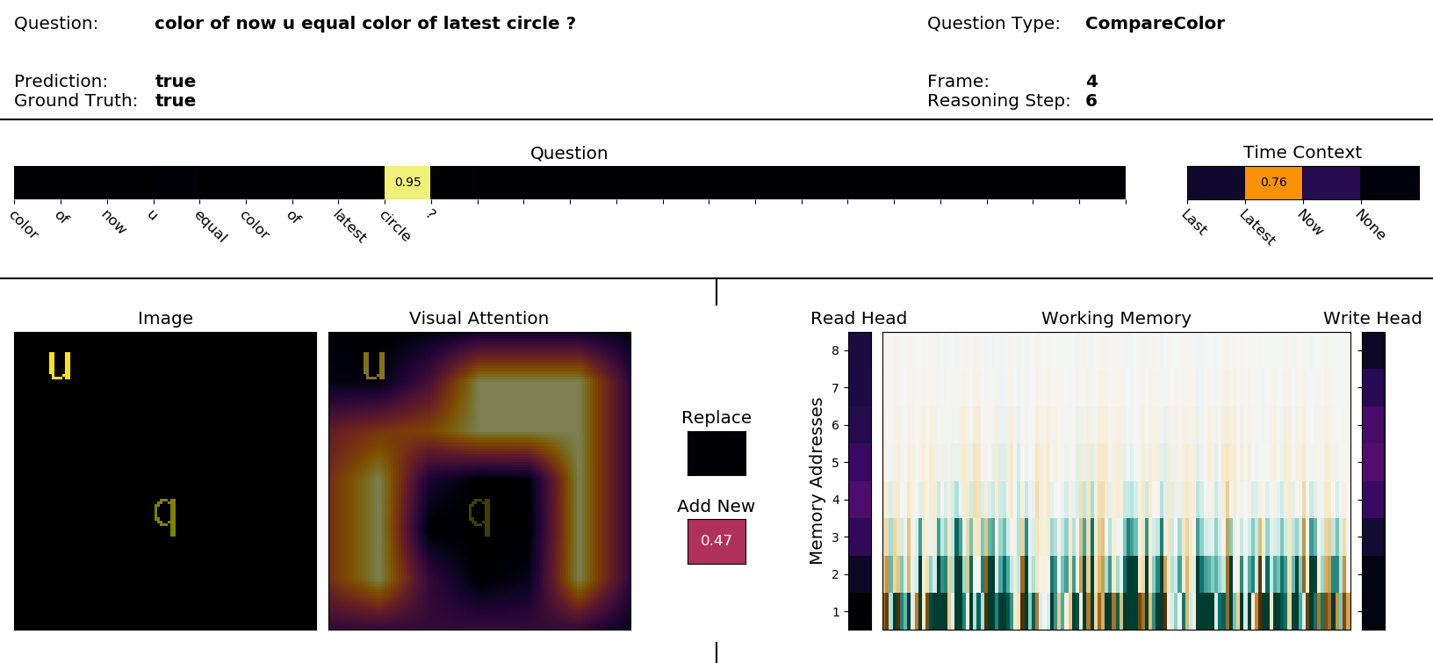

Slide 30
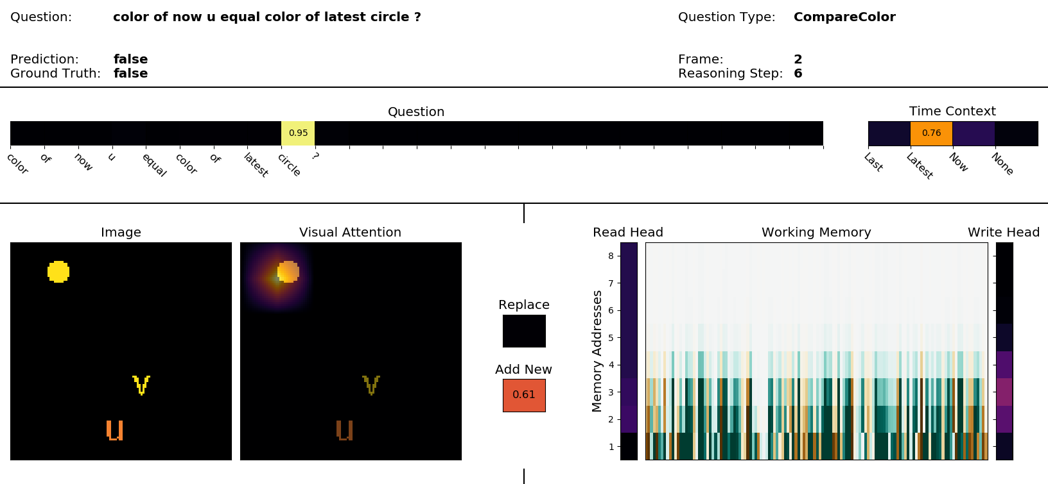

Slide 31
Main Result

Slide 32
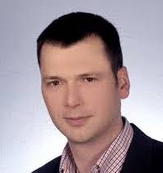





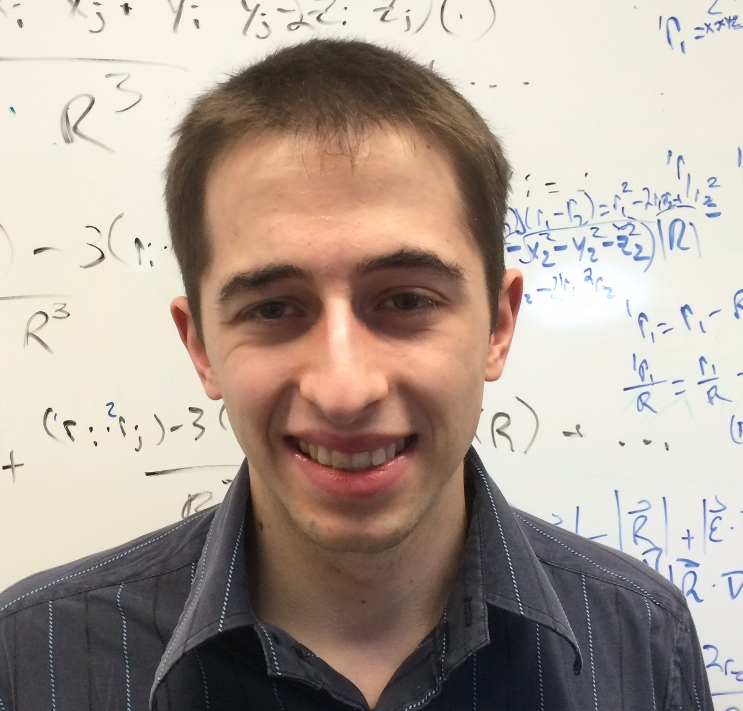
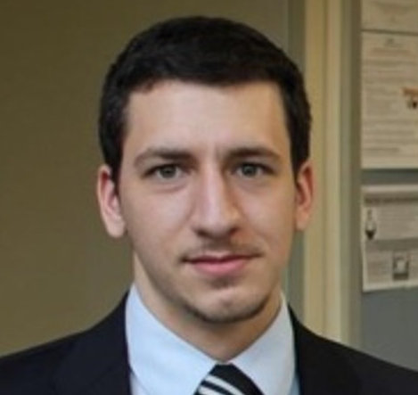
MACHINE
INTELLIGENCE
Tomasz Kornuta
Ahmet Ozcan
Vincent Albouy
Alexis Asseman
Younes Bouhadjar
Vincent Marois
Ryan McAvoy
Emre Sevgen

Slide 33
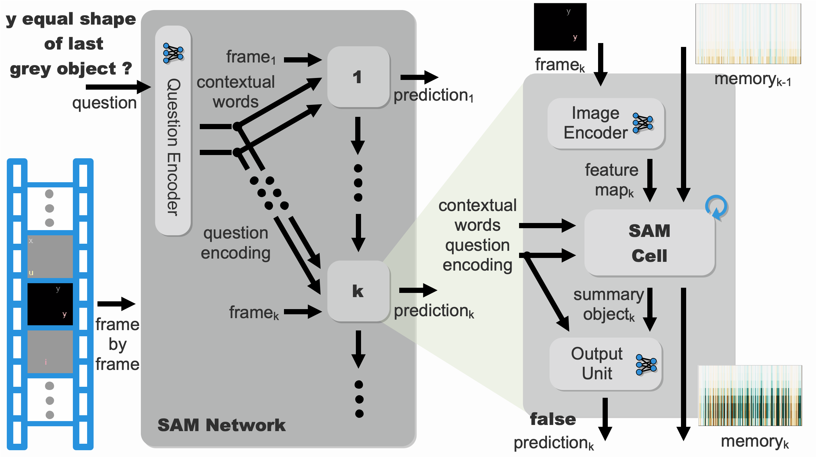

Slide 34
memory
wh_{t-1}
M_{t-1}
so_{t-1}
c_{t-1}
cw
q
F_{k}
SAM Cell
1
Question-driven Controller
contextual
words
c_{t}
c_{t}
so_{t-1}
τ_{t}
Memory Retrieval Unit
Visual
Retrieval Unit
question
encoding
t
rh_{t}
mo_{t}
va_{t}
vo_{t}
rh_{t}
c_{t}
feature
map
Reasoning
Unit
h_{t}ª,h_{t}^{u}
g_{t}^{v},g_{t}^{m}
vo_{t}
mo_{t}
vo_{t}
so_{t-1}
T
Memory
Update Unit
Summary Object
Update Unit
memory
summary object
wh_{t}
M_{t}
c_{t}
so_{t}

